Slide 1
Investor Presentation
SEPTEMBER 2026

Slide 2
Disclaimer
This presentation is for information purposes only. By this presentation, Elron does not intend to solicit offers to purchase its securities and the presentation does not constitute an invitation to receive such offers, and nothing said therein constitutes a “public offering”, as defined in the Israel Securities Law, 5728-1968. The presentation was prepared for the purpose of a general overview of Elron, and as such, the information contained within it is only concise and does not fully encompass all the data about the company and its activities.
Elron may at any time edit and/or change and/or update the features and/or content presented below. In this context, it is clarified that Elron does not undertake to update or change the information included in the presentation to reflect events or circumstances that will occur after the date of preparation of the presentation. The information included in this presentation is concise and partial only and does not claim to provide a comprehensive description of Elron's operations, or to contain all the information that may be relevant for making any decision regarding an investment in Elron's securities. Furthermore, the data in this presentation are not audited or reviewed. Therefore, Elron urges investors to consider the information presented in this presentation in conjuction with the Company's immediate reports, including the periodic reports including the financial statements, which contain all the information about the Company, before making any decision to invest in the Company's securities.
This presentation may include information presented differently from the manner in which it was presented in the Company's periodic and immediate reports. This is because some of the information may be presented and/or classified and/or compiled differently from the Company's previous official periodic and immediate reports.
Nothing in this presentation should be considered "investment advice", as defined in the Israel Regulation of Investment Advice, Investment Marketing and Portfolio Management Law, 5755-1995.
This presentation may be accompanied information of a number of companies held by Elron, either directly or indirectly, and which are in various stages of business development (hereinafter: the "Portfolio
Companies"). It is hereby clarified that: (a) the mere inclusion of a company in the presentation and/or its presentation at the conference does not constitute a recommendation, advice, opinion, solicitation or offer to carry out any transaction in connection with that company and/or Elron, and does not indicate its relative importance to Elron and/or to understanding its business; (b) such information include information from the portfolio companies that was prepared by them and Elron has not performed an independent review or exhaustive verification of its correctness, completeness or timeliness; (c) unless otherwise stated, the data regarding the portfolio companies may be presented, classified or compiled in a manner different from the manner in which data is presented in Elron's public reports.
Certain statements made over the course of this presentation may be forward-looking in nature, as defined in Section 32A of the Israel Securities Law, 5728-1968. Such forward-looking statements involve known and unknown risks, uncertainties, forecasts, assessments, estimates or other information, which relates to a future event or matter whose occurrence is not certain and which is not within the sole control of Elron, and other factors which may cause the actual results, performance and achievements of Elron to be materially different from any future results, performance and achievements implied by such forward-looking statements. These forward looking statements are not proved facts and are based on Elron's subjective assessments which rely on analysis of general information, public publications, researches and reviews, which do not include any liability as to the accurateness or completeness of the information contained there and their accurateness hasn't been examined by Elron. The realization of these forward looking statements will be affected by factors that cannot be assessed in advance and which are not within the control of Elron. Elron assumes no obligation to update the information in this presentation and disclaims any obligation to publicly update or revise any such forward-looking statements to reflect any change in its expectations or in events, conditions, or circumstances on which any such statements may be based, or that may affect the likelihood that actual results will differ from those set forth in the forward-looking statements.
These estimates, in whole or in part, may not materialize, or may materialize in a manner materially different than expected. The principal factors that may affect this are: failure to meet goals, modifications in work plan, goals and/or strategy, unexpected needs of the group companies for additional financing, investment in new companies, any other unexpected expenses, information collected by the group companies in connection with the state of the market, market potential and products, the state of competition and the identity of competitors and their methods of operation, as well as long-term plans and forecasts, errors in data and estimates collected, changes in the state of the market, problems concerning personnel, technological and engineering difficulties, deviation from development schedules, unexpected regulatory problems or regulatory changes, the worsening
of competition, including the development of competing technologies and products, and the like.
Elron urges investors to consider the information presented in slides 3,5,6,9,10 in conjunction with this comment. All amounts are fully attributed to Elron and RDC unless specified otherwise.

Slide 3
Elron Ventures Corporate Overview
Established in 1961, Israel’s first evergreen fund; partnership with Rafael for over three decades
CONTROLLING SHAREHOLDER
PARTNERSHIP WITH RAFAEL, DEFENSE INDUSTRY LEADER
23 Portfolio Companies*
Arieli Group, since Sept. 2024
From Seed to Series E
Joint Investment Vehicle
Boosting deep-tech and cybersecurity ventures, alongside exclusive rights to create civilian spinoffs based on Rafael’s tech
22 Exits**
60+ YEARS INVESTMENT EXPERIENCE
Investing since 1961
Valued at approximately $3.3B since 2010
New M&A Growth Engine
Acquiring controlling stakes in early-stage dual-use defense ventures
INVESTMENT VERTICALS
NOTABLE EXITS
Deep Tech, Defense Tech / Dual Use, Cybersecurity, AI
+ Legacy Healthtech portfolio
CartiHeal, Ironscales, Cybersixgill, Secdo, Cynerio, Astrix
CYBERFUTURE MICROFUND
Cybersecurity microfund of leading CISO’s, VAR’s, and AI architects; 2nd fund under construction
This slide contains forward-looking information as defined in Section 32A of the Israel Securities Law, 5728-1968. See slide 2 of this presentation.
* Including companies held by CyberFuture.
** Including CyberFuture’s exits.

Slide 4



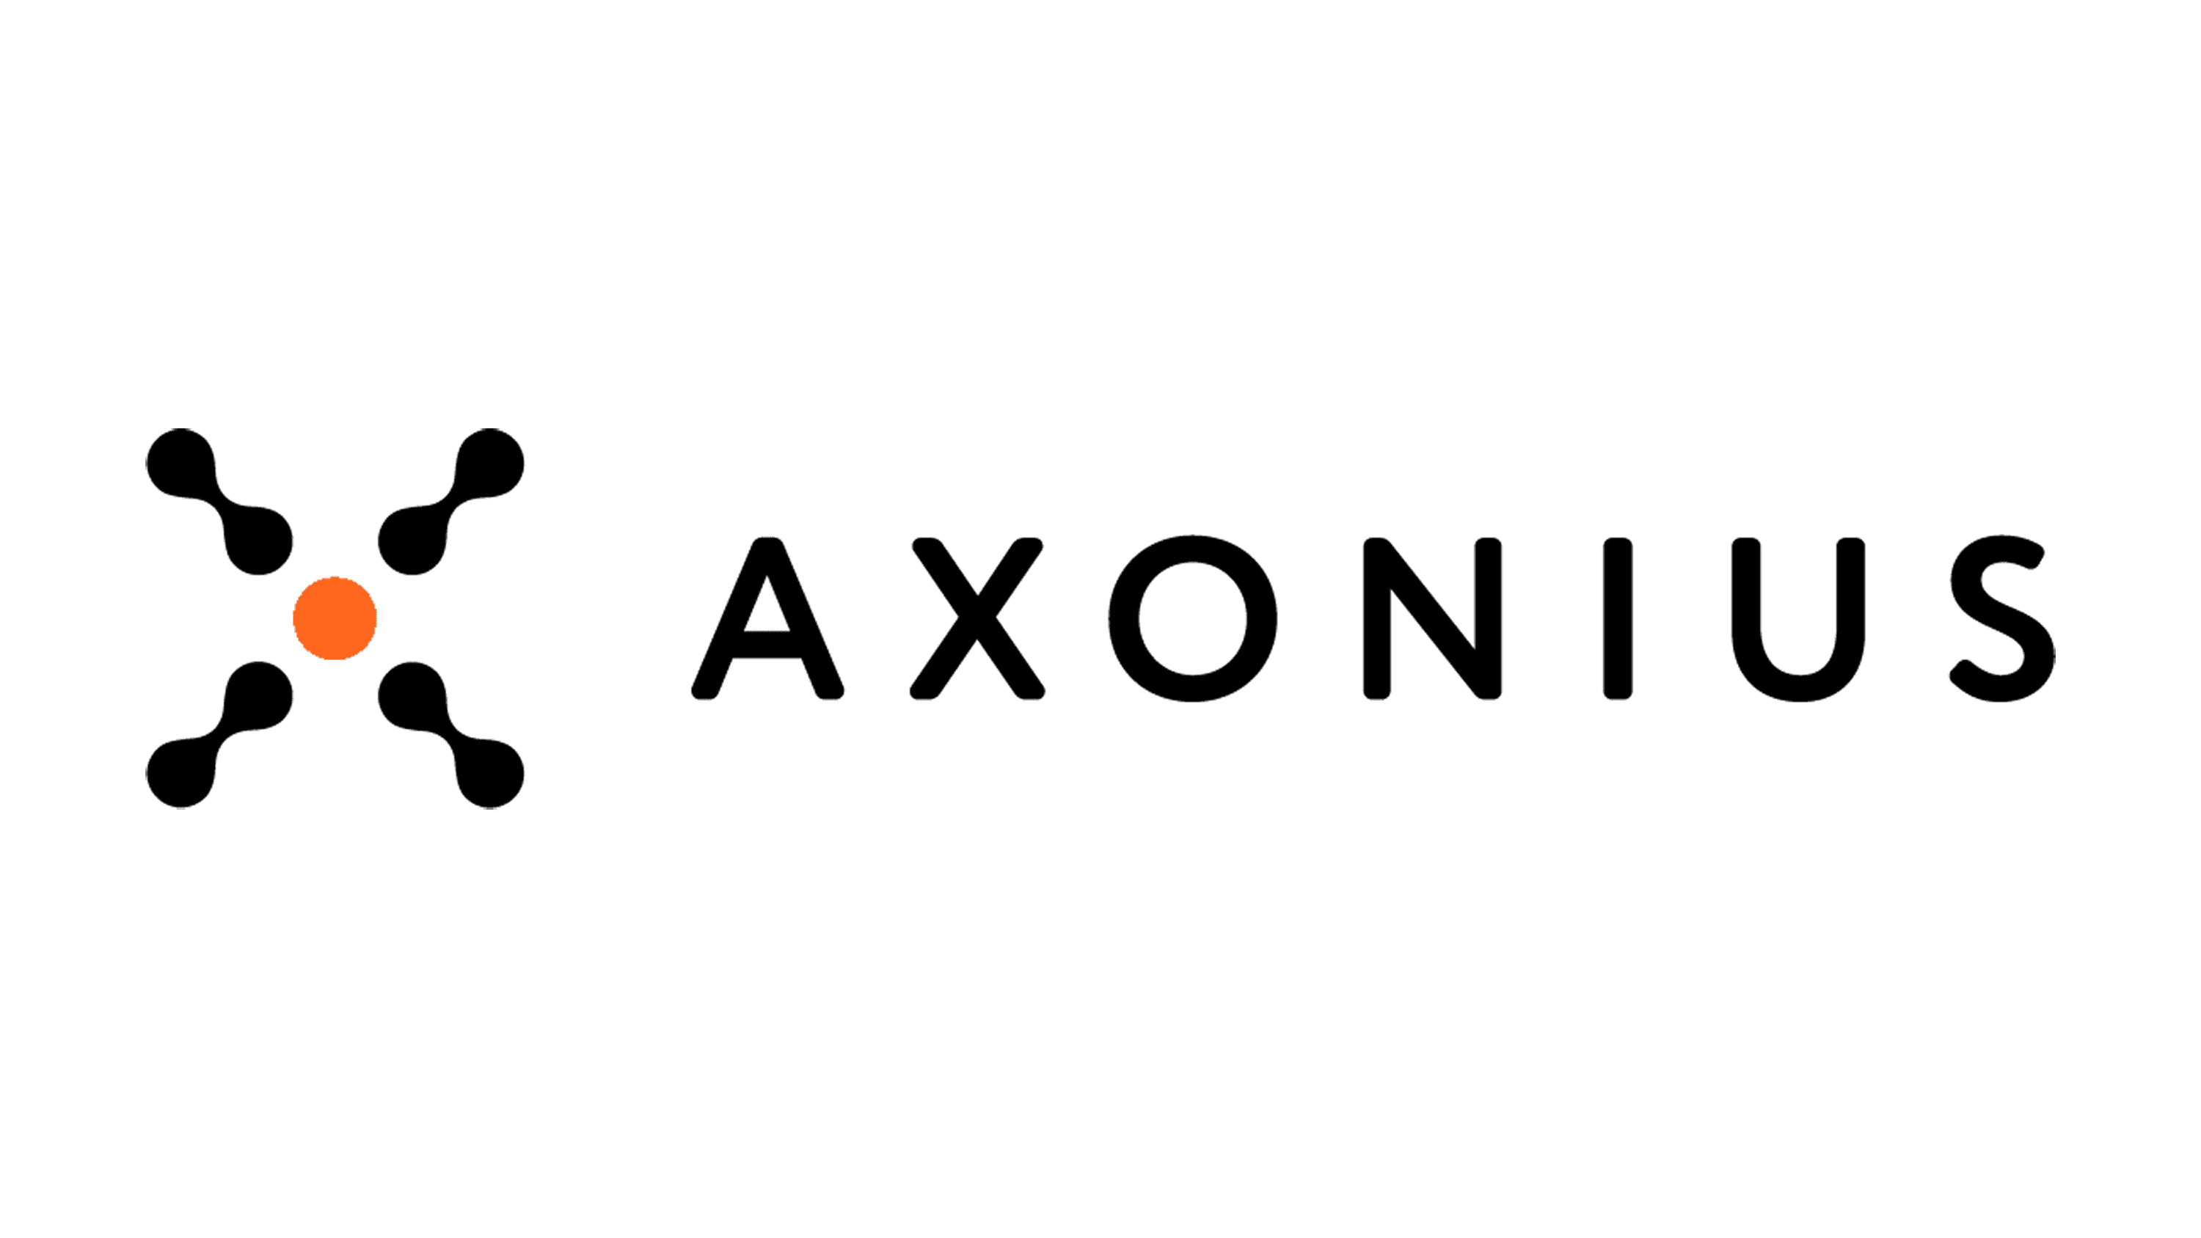


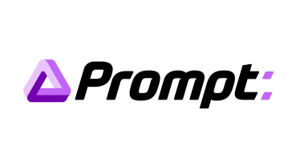
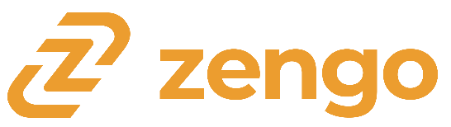




6 exits in the last 24 months – with a total value of approximately $1B*
Since September 2024 Elron has distributed ~$30M
CYBER
CYBER
CYBER
Acquired by:
Acquired by:
Acquired by:
CYBER
CYBER
CYBER
Acquired by:
Acquired by:
Acquired by:
*by Cyberfuture
*by Cyberfuture
2026
2026
* Including CyberFuture’s exits.

Slide 5
Elron Snapshot
Effective and consolidated assets under management
Holdings in companies | Holdings based on valuation of last financing round ^{1,2} ($m, effective) | Holdings based on valuation of last financing round ^{1,2} ($m, consolidated)
Cyber Holdings³ | 43.7 | 73.6
Deep Tech / Defense Tech | 8.4 | 11.3
Medical Holdings | 20.0 | 20.0
Total Holdings | 72.1 | 104.9
Contingent consideration from the CartiHeal deal⁴ | 22.6 | 22.6
Cash & Other Financial Resources :
Liquid resources (as of August 30, 2026) | 41.7 | 54.2
Total | 136.4 | 181.7
¹ Includes Elron Ventures’ direct holdings and its effective indirect holdings through RDC. Includes investments made after June 30, 2026. Effective Holdings Includes Elron Ventures’ balance and 50.1% of RDC’s balance. Consolidated Holdings Includes Elron Ventures’ balance and 100% of RDC’s balance.
² Our holdings based on valuation of last financing round was calculated based on the “post-money” valuation of the last financing round in the companies multiplied by our fully diluted holding percentage. It is clarified that these are financing rounds that were carried out in different companies at different dates, and since which, in some cases, significant time has passed. In some of the financing rounds Elron Ventures opted not to participate.
It should be noted that, even where valuations are available as part of Financial Statements, holdings are calculated based on the above methodology. Accordingly, this includes, among others, investments in Axonius in the amount of $15.2 million, and the investment in Notal Vision in the amount of $16.7 million.
³ The balance in this item is net of tax.
⁴ The balance in this item represents the contingent consideration resulting from the sale of CartiHeal to Smith & Nephew, in accordance with the book value as of December 31, 2025, based on a valuation conducted with the assistance of an external appraiser.
⁵ The above financial data do not represent a valuation, investment advice, or a financial opinion of any kind.

Slide 6
Financial data of Elron (consolidated)*
Consolidated Net asset value
Holdings in companies
Cash and other financial resources
$181.7M
$104.9M
$54.2M
As of August 30, 2026
Cyber/software companies
Liquid resources
$73.6M
$54.2M
$181.7M
Medical companies
Contingent consideration from the CartiHeal deal
$20.0M
$22.6M
Total Net Asset Value
Deep tech / defense tech companies
$11.3M
*All amounts are on a consolidated basis. For additional details and information, see previous slide.
This slide contains forward-looking information as defined in Section 32A of the Israel Securities Law, 5728-1968. See slide 2 of this presentation.

Slide 7
VC Market Trends - Q2 2026
Market Intelligence
Israel's Defense-Tech and Cybersecurity Sectors Hit New Highs
Global acceleration of dual-use technology is reshaping Israeli venture capital – defense-tech and cybersecurity are both setting funding records in H1 2026
$3B Raised in Defense-Tech
33.7% Cyber Share
11.6% — A Historic Peak
5.8% of New Companies
Reported defense-tech funding in H1 2026 alone, alongside a wave of civilian companies pivoting into military systems.
Cybersecurity's share of all capital raised in Israel in H1 2026, versus a 24.7% average over the last decade.
Share of total capital raised in Israel by Defense, Space & Quantum in H1 2026 – now Israel's #3 sector by funding.
Defense & Space's rising share of all new companies formed in Israel, up again in 2025.
CYBERSECURITY MOMENTUM
WHY THIS MATTERS
Sourcing new investments through CyberFuture, Elron's CISO-led microfund
Latest investment: Raven, alongside CyberFuture
Building CyberFuture Fund II, adding VARs and AI architects
Two Strategies Anchored in These Trends
Equity investing in deep tech & defense tech (CyberRidge, Addionics) and controlling-stake acquisitions in dual-use defense companies with Rafael.

Slide 8
RDC: Elron and Rafael’s Partnership
INVESTMENT VEHICLE & NEW M&A GROWTH ENGINE
30 years of Investment Partnership
Boosting Technological, Product and Market Superiority
Mobilizing the right mechanisms and teams at Rafael to work with tech ventures
TECHNOLOGY VALIDATION & DUE DILIGENCE
SPINOFFS BASED ON RAFAEL’S IP
DESIGN PARTNERSHIP WITH PORTFOLIO COMPANIES
GATEWAY INTO HIGH-ENTRY BARRIER MARKETS
We assemble ad-hoc teams for technological assessment of investment opportunities.
E.g. AI, quantum, blockchain, computer vision, system engineering, advanced manufacturing.
We have exclusive rights to commercialize Rafael’s technology in civilian markets.
Rafael tech spinoffs were acquired by strategics.
Helping portfolio companies develop technologies and mature products in an enterprise- and military-grade environment.
Rafael often converts into their 1st enterprise customer.
Rafael can open up markets to portfolio companies both as a direct customer, or as a prime contractor.
Elron and Rafael’s Partnership
Notes:
‹#›

Slide 9
M&A Growth Engine
M&A and Investment Model Structure
Elron and Rafael have each approved an initial budget of $100M ($50M each)
M&A
VC INVESTMENTS
MAJORITY OWNERSHIP
EQUITY INVESTMENTS
EARLY STAGE
EARLY GROWTH
DUAL-USE DEFENSE TECH
DEEP TECH
DEFENSE TECH
CYBERSECURITY
AI
This slide contains forward-looking information as defined in Section 32A of the Israel Securities Law, 5728-1968. See slide 2 of this presentation.

Slide 10
M&A Growth Engine
M&A Investment Plan: Initial Budget
INCREASING CASH RESERVES TO CREATE SHAREHOLDER VALUE THROUGH ACQUISITIONS AND SCALE
RDC INITIAL INVESTMENT PLAN: $100M
RAFAEL FINANCING
$50M
ELRON FINANCING*
$50M
RDC INITIAL BUDGET
$100M
TOTAL (CONSOLIDATED) POTENTIAL AVAILABLE LIQUID RESOURCES**: $129M
ELRON BALANCE SHEET, AUG. 30, 2026 (CONSOLIDATED)
$54M
RAFAEL 1ST YEAR ALLOCATION
$50M
POTENTIAL BANK CREDIT LINE (A BINDING AGREEMENT HAS NOT YET BEEN SIGNED)*
$25M
* Elron is working to secure financing for the M&A investment plan’s initial budget. A binding agreement has not yet been signed. For further details, see Section 3, Part A of the Interim Report as of June 30, 2026.
** Including existing liquid resources of the Company on a consolidated basis, Rafael's share of the initial investment budget.
Corporate approvals are in place to extend the investment plan’s scope up to $300M over the next 3 years, at Elron and Rafael’s discretion.
This slide contains forward-looking information as defined in Section 32A of the Israel Securities Law, 5728-1968. See slide 2 of this presentation.

Slide 11
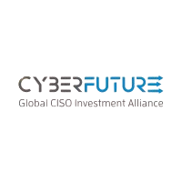



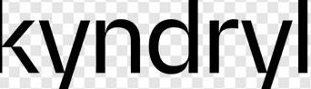

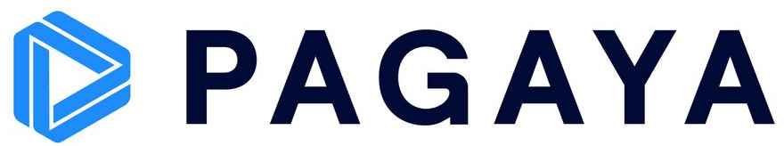


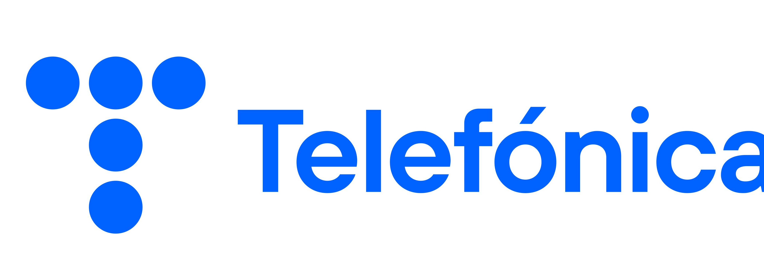
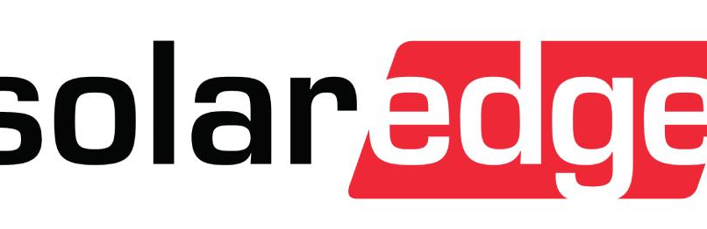
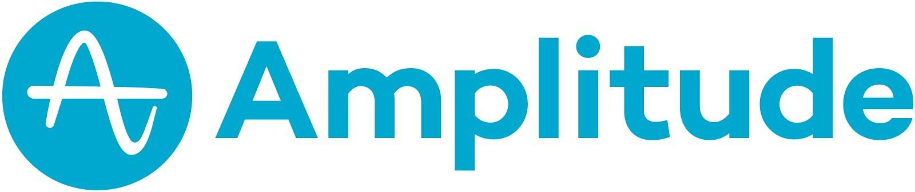
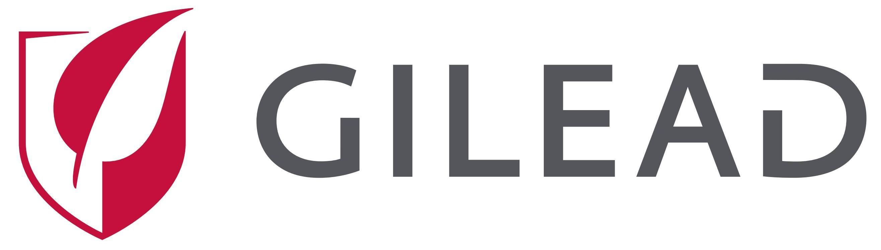


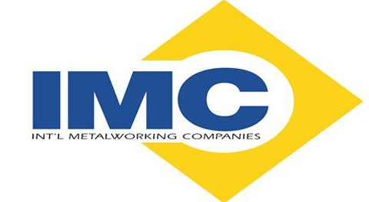
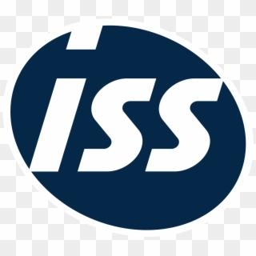










Elron’s Early-Stage Cybersecurity Micro-Fund: Our Deal Flow Engine Powered by CISOs, VARs, and Cyber & AI Experts
Our Micro-Fund:
Investments made by CISOs, VARs and cyber/AI experts, with resumes from leading global organizations.
WHY NOW, MORE THAN EVER
The AI revolution is reshaping cybersecurity itself – creating both the threat and the opportunity. CyberFuture Fund II is now open for new investments.
CISO & Cyber/AI Investors
Strategic Advisors Alliance
CyberFuture showcases a select group of top CISOs with resumes from leading global organizations.
~10 CISOs and cyber/AI experts who invest directly in the fund and recommend deals.
A flexible circle of technology leaders who guide and support — our ‘ears to the ground,’ in collaboration with Rafael’s IT division.
THE ADVANTAGE — WHY LEADING CYBER COMPANIES WANT CYBERFUTURE’S MONEY
Our tech & AI experts deliver real, hands-on value – product, GTM, positioning. Our CISOs are the actual buyers of cyber solutions – they know exactly what the market needs, which trends matter, and which technologies win. And this access runs both ways: alongside every CyberFuture investment, Elron’s other vehicles – RDC and Evergreen – gain the opportunity to invest too.
CyberFuture Fund I – invested to date:
PORTFOLIO
SOLD
SOLD
SOLD
NEW
Elron is the only partner in the partnership that is obligated to finance its expenses and investments, in a total amount of up to $2M.

Slide 12
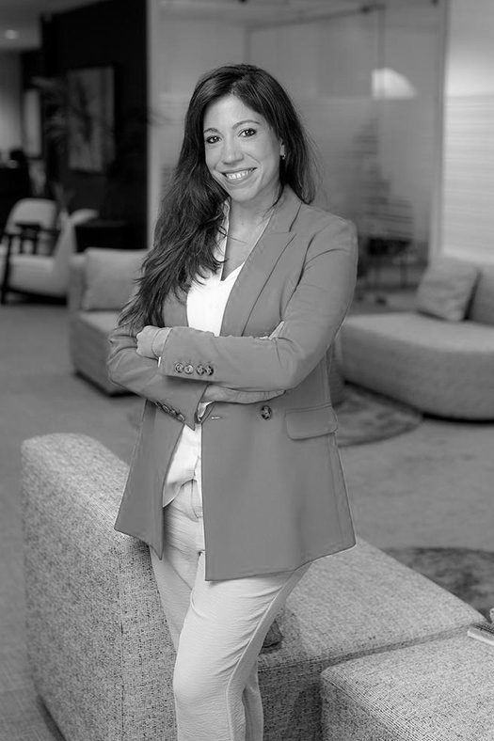
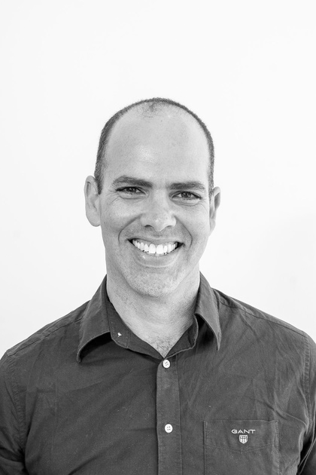
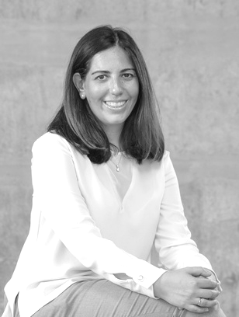
Knowledge & Experience Combined
Meet Elron Management Team:
to accelerate investment scaling and growth.
Lisya Bahar Manoah
Chairperson
Yaniv Shnieder
CEO
Rony Gur Arie
CFO
Managing Partner @ Arieli Group, the controlling shareholder of Elron Ventures. >15 years of investment and management expertise in PE & VC, in managing funds, executing M&A transactions, and leading post-merger integrations.
Seasoned technology leader with 25 years of deep tech and defense tech experience. Founded and led Rafael’s Tel Aviv R&D Center, building it into a multidisciplinary, startup-style engineering group of 250 top-tier talents.
Joined Elron Ventures 10 years ago. Oversees the financial operations and serves as active CFO in portfolio companies. Broad experience in accounting, financing, taxation, and securities regulations.

Slide 13
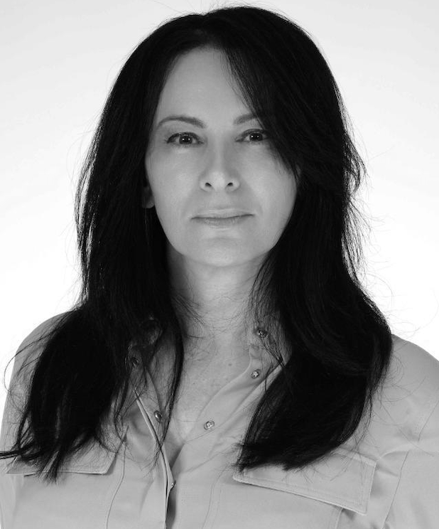
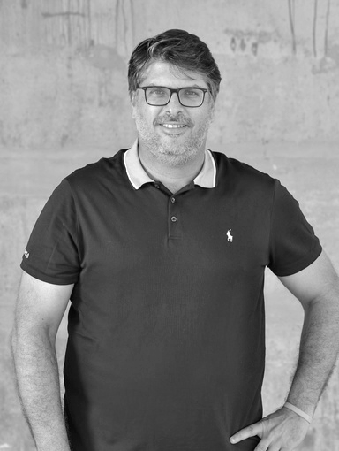
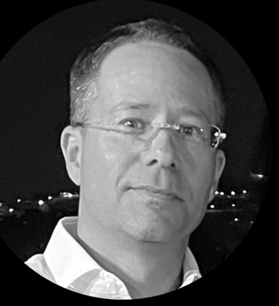
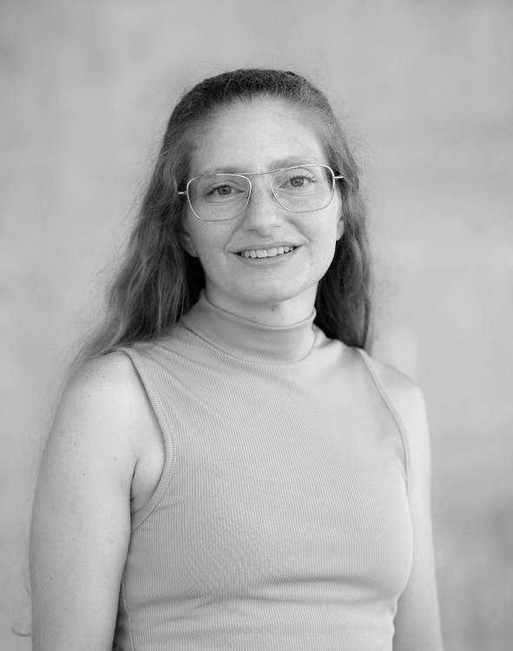
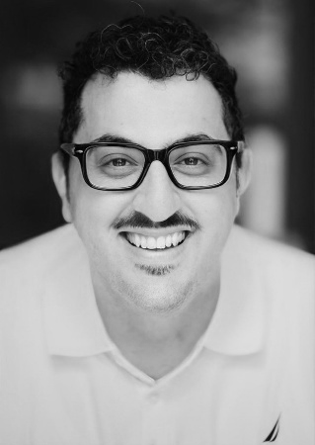
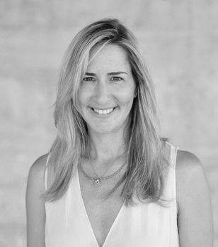
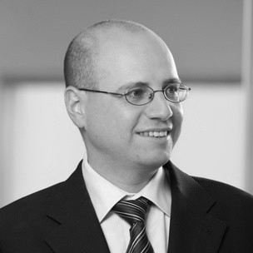
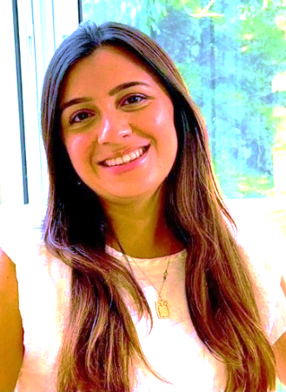
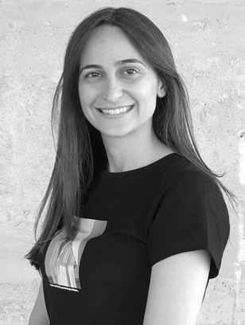
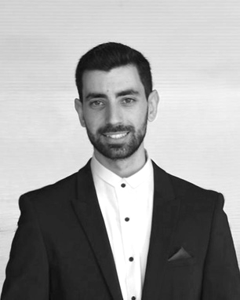
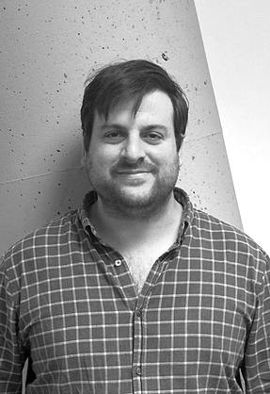

Elron’s joint team with Rafael
Meet Elron Team:
Lisya Bahar Manoah
Chairperson
Yaniv Shnieder
CEO
Co-CEO @RDC
Rony Gur Arie
CFO
Liat Shechter Nakash
Co-CEO @RDC
General Counsel in Rafael
Lior Levinsky
CFO@RDC
The strength of our team lies in seamless collaboration and extensive expertise.
Erez Berkovich, Phd CTO @RDC
Chief Scientist @Rafael
Lauren Duke
VP Business Development
Yishay Perry
Senior Cyber Advisor
Maya Reitman
Head of Marketing
Ofer Hanoh
Legal Counsel
Betsy Kalaora
Operations Manager
Ortal Shpigelshtein
Corporate Controller
Nir Kahlon
Controller
Benny Hagay
Assistant Controller
Chen Hendelsman
Office Manager
Notes:
‹#›

Slide 14
Our Portfolio & Recent Investments

Slide 15

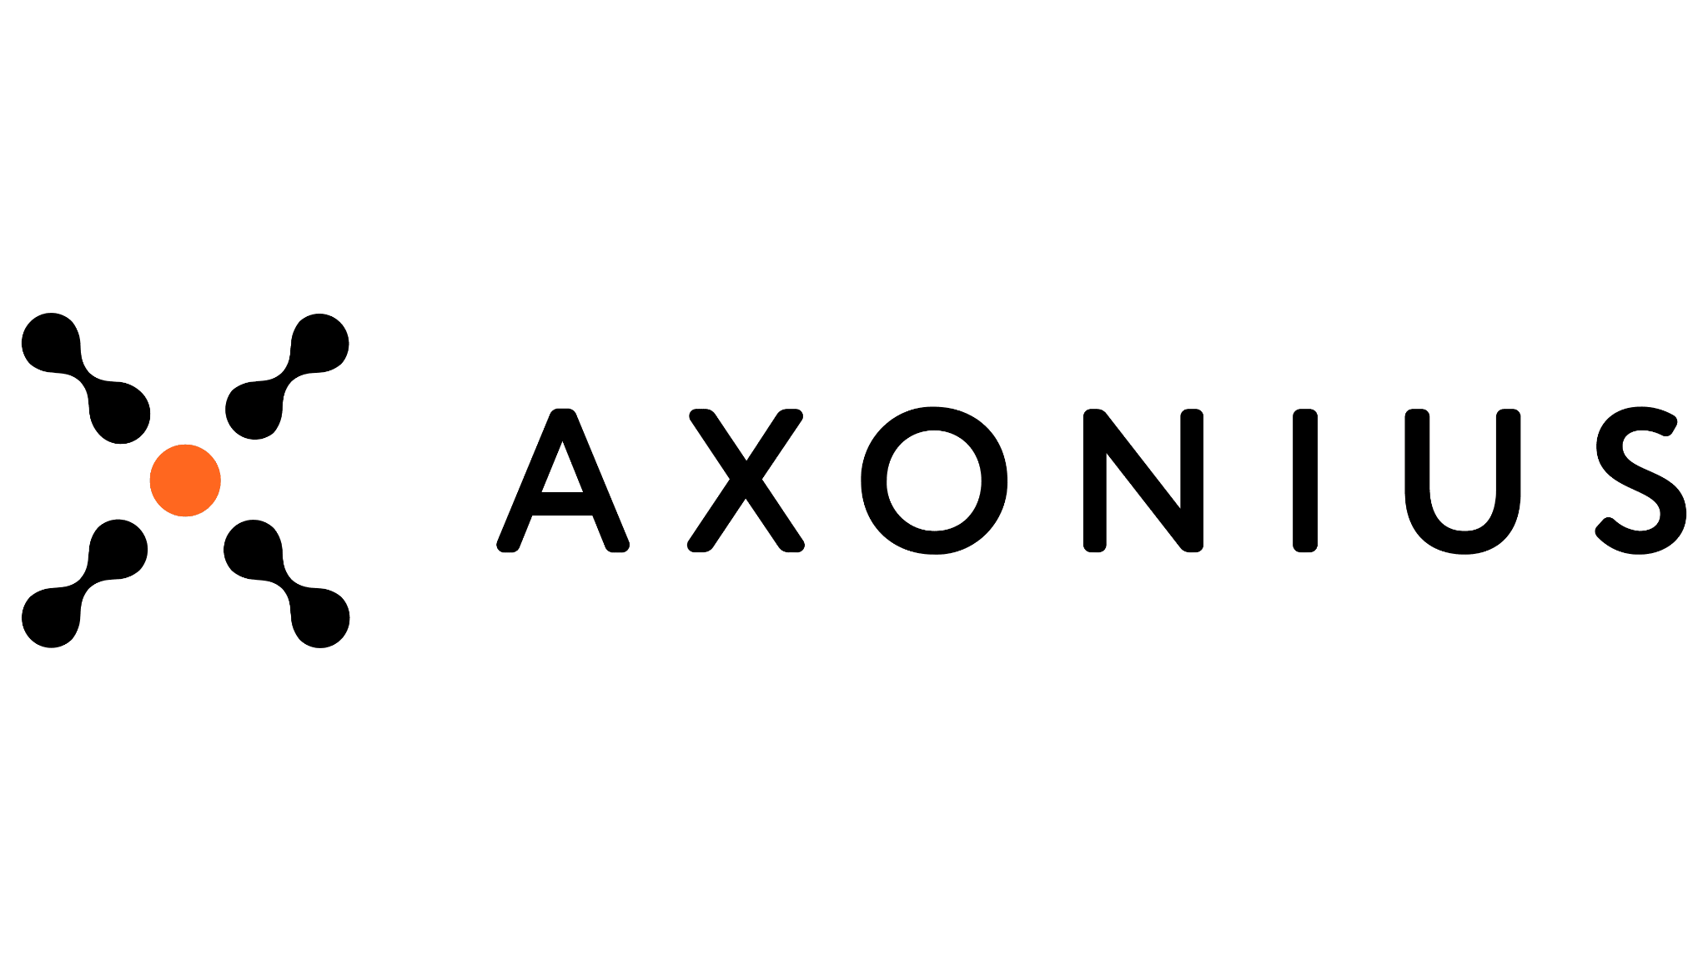
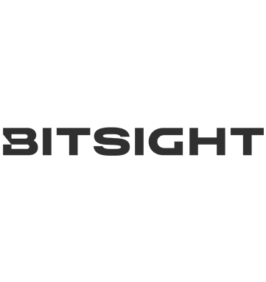


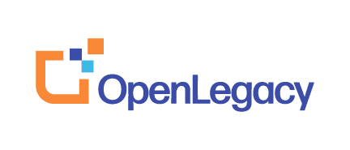

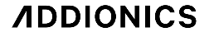
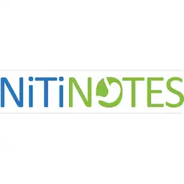








Elron Portfolio Snapshot
Companies crossing all stages as a growth catalyst for the coming years
Legend
Cybersecurity
Medtech
New
SaaS
Deep Tech / Defense Tech
D →
Seed
Round A
Round B
Round C
E →
E →

Slide 16
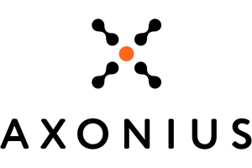

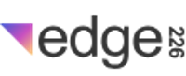

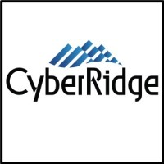


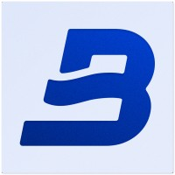
Portfolio Overview
Growth Companies
BITSIGHT
AXONIUS
NOTAL VISION
EDGE 226
Cybersecurity ratings and risk intelligence for organizations (**)
Cybersecurity asset management platform that secures and manages connected devices for businesses (*,**)
Remote monitoring of patients with age-related macular degeneration
8%
Performance-based ad exchanges for ad networks
24%
Our investment
$16.0m
Our investment
$2.5m
Early Growth Companies
CYBERRIDGE
RED ACCESS
TAMNOON
BREEZE
Photonic encryption for quantum-safe data transmission
11%*
Third generation web protection platform
21%*
Tech-driven managed cloud protection service
7%*
AI-based enterprise cybersecurity program & posture management
13%*
Our investment
$5.7m
Our investment
$3.3m
Our investment
$2.3m
Our investment $4.5m
Option for an +$1m
Legend:
Cybersecurity
Medtech
SaaS
Deep Tech /
Defense tech
*Held by RDC (except CyberRidge - held by Elron & RDC in equal proportion)
** Holdings resulting from equity-based exit transactions, each representing less than 1% ownership.

Slide 17
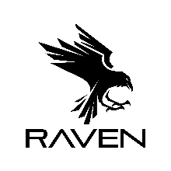


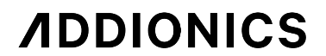
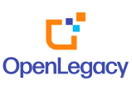


Portfolio Overview:
Early Growth Companies
New
CYVERS
WONDER
ROBOTICS
ADDIONICS
RAVEN
Cryptocurrency attack detection in real-time using AI- based behavioral profiling
26%
Intelligent and robust 360° self- awareness software for drones
30%*
Advanced current collectors for improving battery performance in the electric vehicles and defense segments
3%*
Runtime application protection that stops malicious code execution before it runs
10%
Our investment
$5.1m
Our investment
$2.9m
Our investment
$3.5m
Our investment
$3.7m**
OPENLEGACY
NITINOTES
BARK
22%*
9%
Revenue optimization platform for ecommerce merchants
SAFE
Automated API integration platform that speeds digital transformation
Minimally invasive endoscopic device for treatment of obesity
Our investment
$9.0m
Our investment
$4.8m
Our investment $1.2m
Legend:
Cybersecurity
Medtech
SaaS
Deep Tech / Defense tech
*Held by RDC
**Held by Elron & RDC in equal proportion and Co-investing alongside CyberFuture

Slide 18

CyberRidge
Dual-Use Deep Tech
Post-Quantum Optical Security for Data-in-Transit
No algorithm, AI model, or quantum computer can decrypt data that was never a decipherable signal – only CyberRidge’s proprietary photonic key, changing every fraction of a second, can recompose it, and only in that exact instant – without it, the data is lost forever.
Optical Noise, Not Encryption
75% Chance by 2030
Weeks, Not Years to Deploy
Already Trusted By
Transforms data over public infrastructure into optical noise no computer can process – spread across the spectrum, modified by a photonic key, and buried below noise.
A cryptographically relevant quantum computer is 75% likely by 2030 (Gartner) closing the Harvest-Now-Decrypt-Later gap today, not after it opens.
Works with existing fiber – no rip-and-replace, no new infrastructure required.
A Tier-1 European & Asia-Pacific telecom group, a global defense and engineering conglomerate, a national fiber operator, and a national defense organization.
THE PRODUCT
STATUS
Photonic Encryption for Existing Fiber
Sole vendor, Gartner’s new “Harvest Protection” category (2026)
Vodafone flagship-lab POC – 205 km, zero failures
Winner, Global InfoSec Awards 2026
Gartner Cool Vendor in Data Security, 2025
Transforms critical data over high-capacity public infrastructure into optical noise that no computer power can process – the signal is spread over a huge optical spectrum, modified by a photonic key, and buried below optical noise.

Slide 19
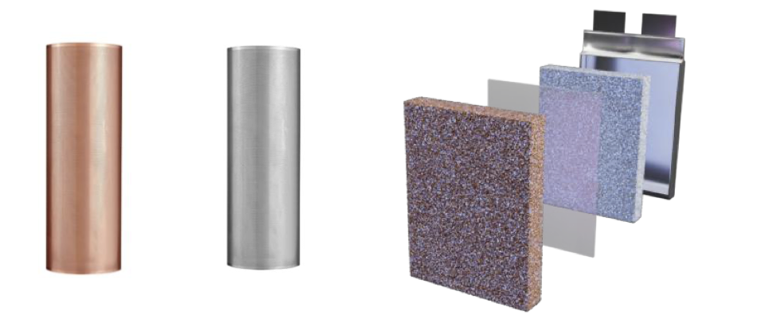
Addionics
Dual-Use Defense Tech
Redesigning battery architecture – higher performance, lower cost, any chemistry
Addionics doesn’t bet on a battery chemistry – it makes every chemistry better, already at commercial scale, and built for the always-on AI era.
Physics, Not Chemistry
Defense: Live Design Partnership
Autonomous Architecture™ - July 2026
Already at Commercial Scale
60% longer lifetime, 12% higher energy density, and 10% lower cost – a physics-based architecture that works with any battery chemistry, current or emerging, and drops into existing assembly lines.
Advancing collaboration with a leading defense fund and design partner, developing high-performance drone batteries for fast discharge, low weight, and high energy density.
New battery architecture purpose-built for always-on AI machines: robotaxis, humanoid robots, drones, and defense systems.
World’s first commercial manufacturing facility for 3D Porous Current Collectors, partnering with major OEMs and automakers.
OPERATIONS: US | EU | Asia | UK | IL
THE PRODUCT
STATUS
Smart 3D Current Collectors
Announced Addionics Autonomous Architecture™ - built for 24/7 operation.
Solves accelerated degradation and oversizing under continuous, AI-era cycling.
Enables larger operating windows for autonomous systems while preserving battery health.
An engineered 3D metal structure that replaces conventional flat foils inside the cell, coated using the industry’s standard processes – a true drop-in upgrade, not a new material to qualify.

Slide 20

Raven
Cybersecurity
Runtime protection that stops malicious code before it runs – CVE or not
70% of enterprise exploits have no CVE at the time of attack – Raven stops malicious code the moment it would execute, inside the application, in real time.
Runtime, Not Reactive
A $47.55B Market by 2037
Platform, Not Point Solution
Already Trusted By
Patented eBPF-based technology observes real execution inside the running application – no code injection, no instrumentation, under 0.4% CPU overhead.
The global runtime application self-protection (RASP) market is projected to grow from ~$2.5B in 2026 at a 32.8% CAGR.
Five runtime modules under one engine – Prevention, AI Agents, Gatekeeper, ADR, and SCA – covering the software factory end to end.
Favor, SageSure, gopuff, Windward, and Zesty rely on Raven in production, across Kubernetes, containers, and cloud compute.
THE PRODUCT
STATUS
Runtime Protection Suite: Prevention · AI Agents · Gatekeeper · ADR · SCA
Selected as one of the Top 10 Promising HLS (Homeland Security) & Dual-Use Startups by HLS.IL.
Recognized for its mission to help organizations prevent exploits in the AI-driven threat era.
5-minute setup, cloud or on-prem, across Kubernetes, containers, and compute instances – no code changes required.

Slide 21
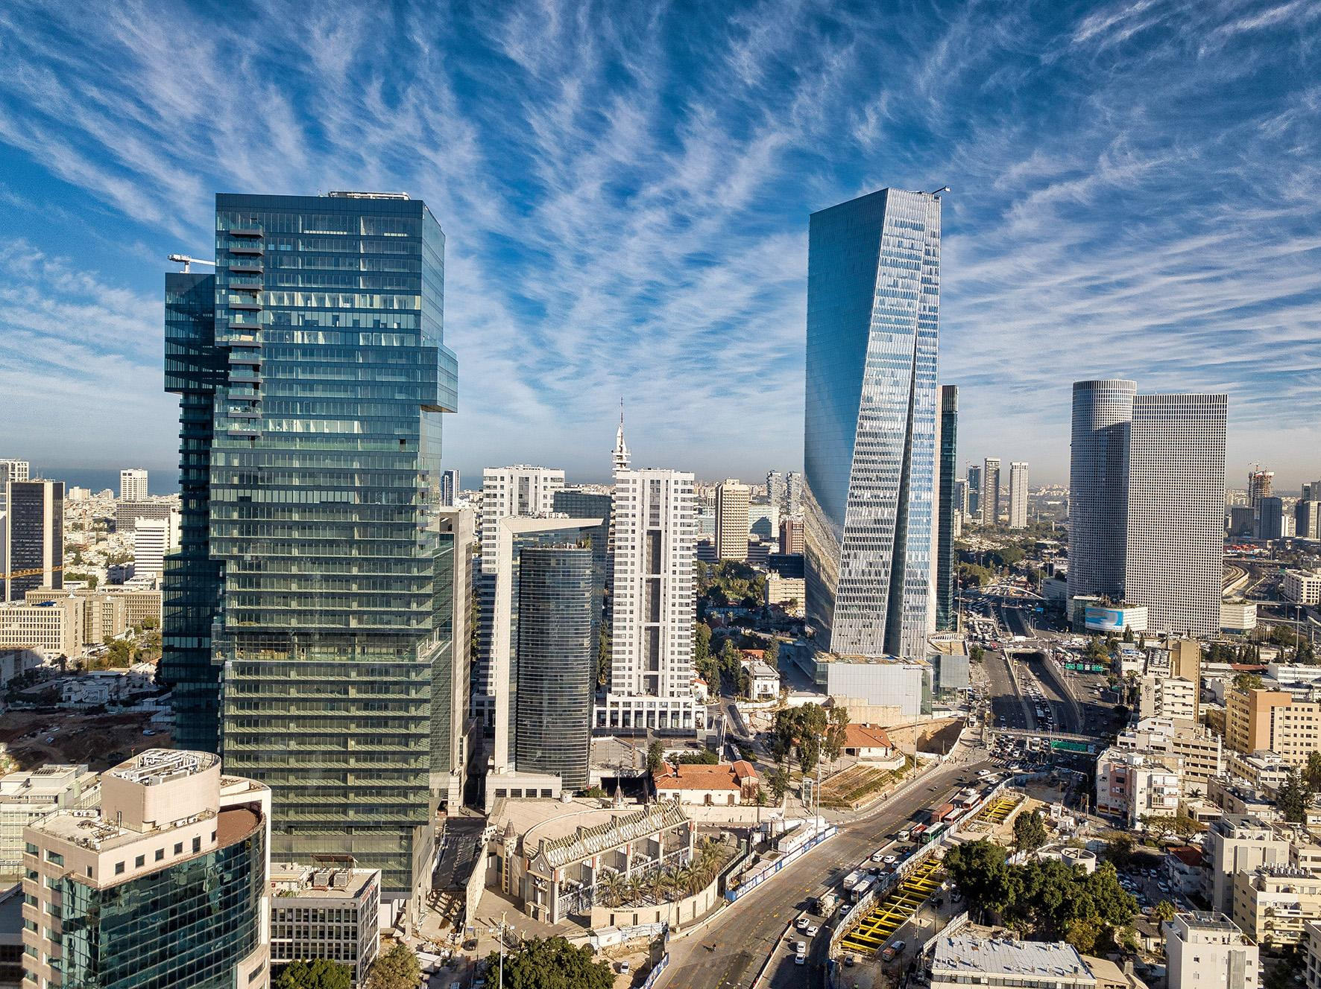
Thank You!
ELRONVENTURES.COM
Lisya Bahar Manoah
Active Chairperson
Yaniv Shnieder
CEO
lisya@elron.com
yaniv@elron.com

